Slide 1
Economic Indicators Analysis: Trends from 2010 to 2023
FABINA THASNI TK

Slide 2
INTRODUCTION
Economic indicators are essential in evaluating the overall economic health and performance of a country. These indicators provide insights into macroeconomic factors such as inflation, GDP growth, unemployment, and interest rates, as well as stock market performance. For businesses, investors, and policymakers, such metrics offer vital guidance in making informed decisions.
The dataset "economic_indicators_dataset_2010_2023" simulates real-world economic conditions from 2010 to 2023. The data is modeled after trusted sources like the World Bank, International Monetary Fund (IMF), Organization for Economic Cooperation and Development (OECD), and national stock exchanges. It contains key economic indicators for various countries, including inflation rates, GDP growth, unemployment, interest rates, and stock index values.

Slide 3
DATA SOURCES:
The data has been generated to simulate real-world economic conditions, information from trusted sources like:
World Bank for GDP growth and inflation data
International Monetary Fund (IMF) for macroeconomic data
OECD for labor market statistics
National Stock Exchanges for stock market index values

Slide 4
Date: The specific date or year for which the economic data is recorded. This column helps track changes in economic indicators over time.
Country: The name of the country corresponding to the economic data. This column allows for comparisons between different countries' economic performances.
Inflation Rate (%): The percentage change in the general price level of goods and services over a specific period, indicating the rate at which prices are rising. High inflation can erode purchasing power.
GDP Growth Rate (%): The percentage increase in a country's Gross Domestic Product, representing the economic performance and growth over time. A positive GDP growth rate indicates a growing economy.
Unemployment Rate (%): The percentage of the labor force that is unemployed and actively seeking employment. This metric reflects the health of the labor market.
Interest Rate (%): The percentage charged on borrowed money or paid on savings, influencing economic activity, investment, and consumer spending.
Stock Index Value: A numerical value representing the performance of a selected group of stocks, which indicates the overall health of the stock market and investor sentiment in a country.¶

Slide 5
OBJECTIVE
The objective of this analysis is to:
Visualize trends in key economic indicators across different countries from 2010 to 2023.
Understand the relationships between economic variables such as GDP growth, inflation, interest rate and unemployment.

Slide 6
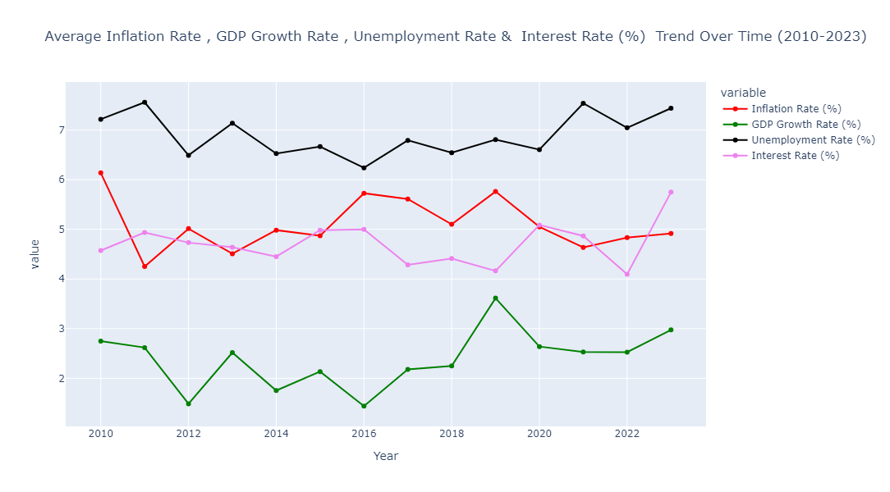
Average Inflation Rate , GDP Growth Rate , Unemployment Rate & Interest Rate (%) Trend Over Time (2010-2023)
Unemployment Rate (Black Line):
Remained consistently high, especially in the early years (around 7%).
It maintained a steady level with minimal fluctuations, but rose in the 2020-2022 period.
Inflation Rate (Red Line):
Started relatively high in 2010 (around 6%).
Showed a fluctuating trend, peaking around 2015, before stabilizing and slightly declining towards 2023.
Interest Rate (Purple Line):
Remained steady around 5% in the early years.
It dropped after 2016 and started rising again after 2020, spiking sharply towards 2023.
GDP Growth Rate (Green Line):
Declined between 2010 and 2012.
It fluctuated over the years, but there was a notable peak around 2018-2020.
The GDP growth rate has been relatively low in the recent years compared to early 2010s.

Slide 7
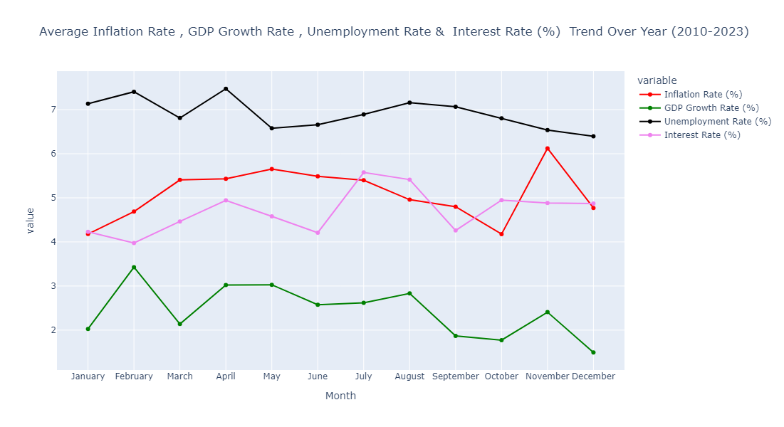
Average Inflation Rate , GDP Growth Rate , Unemployment Rate & Interest Rate (%) Trend Over Year (2010-2023)

Slide 8
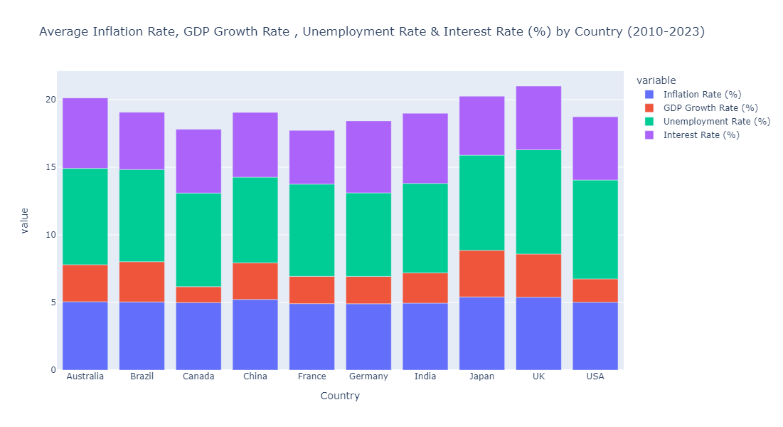
Average Inflation Rate, GDP Growth Rate , Unemployment Rate & Interest Rate (%) by Country (2010-2023)

Slide 9
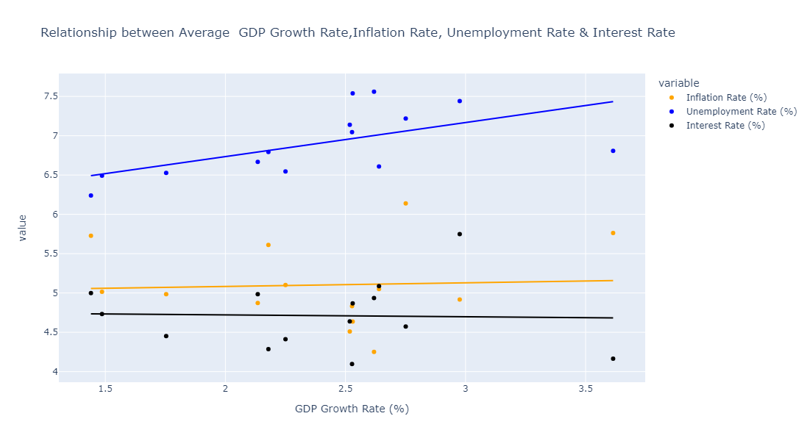
Relationship between Average GDP Growth Rate,Inflation Rate, Unemployment Rate & Interest Rate
Inflation Rate (yellow dots):The inflation rate remains relatively stable across different GDP growth rates, showing minimal variation. There is no clear trend or strong correlation between inflation and GDP growth.
2. Interest Rate (black dots):The interest rate (black) stays mostly flat and consistent across the range of GDP growth rates, indicating very little to no relationship between the two variables.
3. Unemployment Rate (blue dots):There is a slight upward trend in the unemployment rate as GDP growth increases, though the relationship is not very strong.
In summary:
Inflation rate and interest rate show stability and no clear relationship with GDP growth.
Unemployment rate shows a weak positive trend with GDP growth.

Slide 10
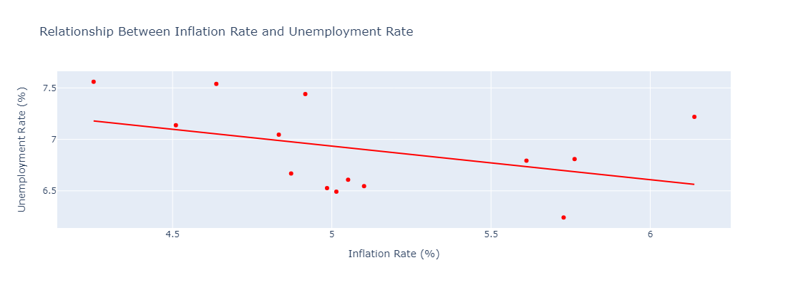
Relationship Between Inflation Rate and Unemployment Rate
There is a slight negative correlation between inflation rate and unemployment rate. As the inflation rate increases, the unemployment rate tends to decrease.

Slide 11
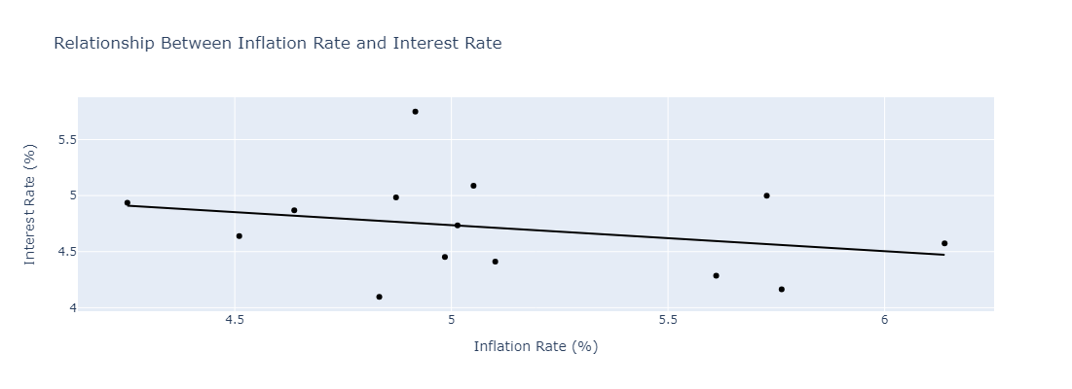
Relationship Between Inflation Rate and Interest Rate
There is a weak negative relationship between inflation and interest rates, meaning that as inflation increases slightly, interest rates tend to decrease, but the pattern is not very strong or consistent. However, the scattered data points show some irregularities in this trend.

Slide 12
INDIA’S CURRENT ECONOMIC INDICATORS
GDP Growth Rate: India’s GDP growth is around 6-7%, driven by technology, manufacturing, and services.
Inflation Rate: Inflation hovers around 5-6%, influenced by food and fuel costs; RBI targets 4% (+/- 2%).
Unemployment Rate: Unemployment ranges from 6-8%, with efforts to boost skills and entrepreneurship.
Interest Rate: RBI's repo rate is about 6.5%, adjusted to control inflation and support growth.

Slide 13
ECONOMIC INDICATORS FOR KERALA
GDP Growth Rate: Kerala's GDP growth is around 5-6%, driven by services, remittances, tourism, and agriculture.
Inflation Rate: Inflation is generally around 5-6%, influenced by agricultural output, fuel prices, and food imports.
Unemployment Rate: Unemployment is relatively high, about 10-12%, with limited job opportunities despite high education levels.
Interest Rate: Interest rates follow national trends, with the RBI’s repo rate around 6.5%, affecting loans and deposits.

Slide 14
RECOMMENDATIONS
Steady GDP Growth:
Promote Innovation and R&D
Support Small and Medium Enterprises (SMEs
Diversify the Economy
Controlled Inflation:
Implement Prudent Monetary Policy
Stabilize Currency Fluctuations
Enhance Agricultural and Food Security
Monitor Wage Growth and Productivity
Low Unemployment:
Encourage Education and Skill Development
Promote Labor Market Flexibility
Support Job Creation in Emerging Sectors
Strengthen Social Safety Nets

Slide 15
CONCLUSION:
In summary, countries that focus on steady growth, keeping inflation low, and reducing unemployment are better positioned for long-term success.
By investing in infrastructure, supporting job creation, and managing inflation, they build a stronger and more stable economy that can handle challenges and thrive over time.

Slide 16
THANK YOU

